Slide 1
Simulation and Modeling
CSE4131_CSE4132

Slide 2
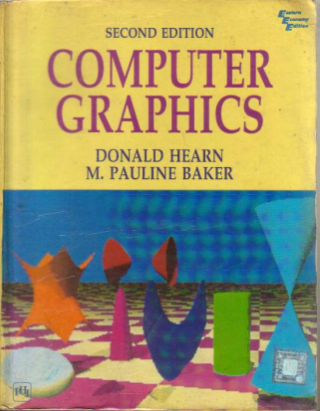
Reference Book
Computer Graphics (2nd Edition)
D. HEARN
M. P. BAKER

Slide 3
Some Commonly Used Splines
Some commonly used Splines and their matrix and blending-function specifications
Cubic Spline Interpolation Method
Natural Cubic Splines
Hermit Spline
Cardinal Splines
Kochanek-Bartels Splines

Slide 4
Kochanek-Bartels Splines
These interpolating cubic polynomials are extensions of the cardinal Splines.
Two additional parameters are introduced into the constraint equations defining Kochanek-Bartels splines to provide for further flexibility in adjusting the shape of curve sections.

Slide 5
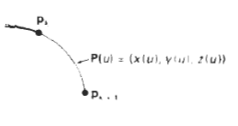
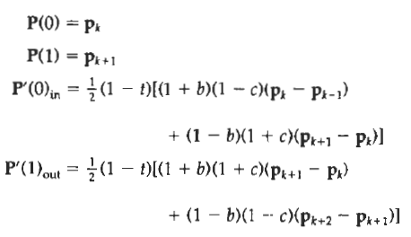
Kochanek-Bartels Splines
Given four consecutive control points, labeled p_{k-1}, p_{k}, p_{k+1}, and P_{k+2}, we define the boundary conditions for a Kochanek-Bartels curve section between p_{k} and p_{k+ I} as:
where t is the tension parameter, b is the bias parameter, and c is the continuity parameter.
In the Kochanek-Bartels formulation, parametric derivatives may not be continuous across section boundaries

Slide 6
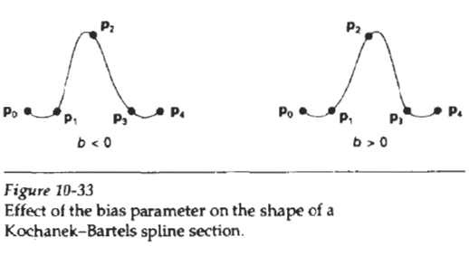
Kochanek-Bartels Splines
Tension parameter t has the same interpretation as in the cardinal-spline formulation;
that is, it controls the looseness or tightness of the curve sections.
Bias (b) is used to adjust the amount that the curve bends at each end of a section
so that curve sections can be skewed toward one end or the other (Fig. 10-33).
Parameter c controls the continuity of the tangent vector across the boundaries of sections.
If c is assigned a nonzero value, there is a discontinuity in the slope of the curve across section boundaries.

Slide 7
SPLINE
Spline
Interpolation
Cubic Spline Interpolation Method
Natural Cubic Splines
Hermit Spline
Cardinal Splines
Kochanek-Bartels Splines
Approximation
Bezier curves and surfaces
B-spline curves and surfaces
Beta-Splines
Rational Splines

Slide 8

BEZIER CURVES AND SURFACES
This spline approximation method was developed by the French engineer Pierre Bezier for use in the design of Renault automobile bodies.
Reasons of popularity:
Bezier Splines have a number of properties that make them highly useful and convenient for curve and surface design.
They are also easy to implement

Slide 9
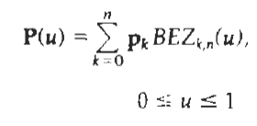


BEZIER CURVES AND SURFACES
Suppose we are given n + 1 control-point positions: p_{k} = (x_{k}, y_{k}, z_{k}), with k varying from 0 to n.
These coordinate points can be blended to produce the following position vector P(u), which describes the path of an approximating Bezier polynomial function between p₀ and p_{n}.
Eq. 10.40
Eq. 10.41
The Bezier blending functions BEZ_{k,n}(U) are the Bernstein polynomials:
where the C(n, k) are the binomial coefficients:
Eq. 10.42

Slide 10

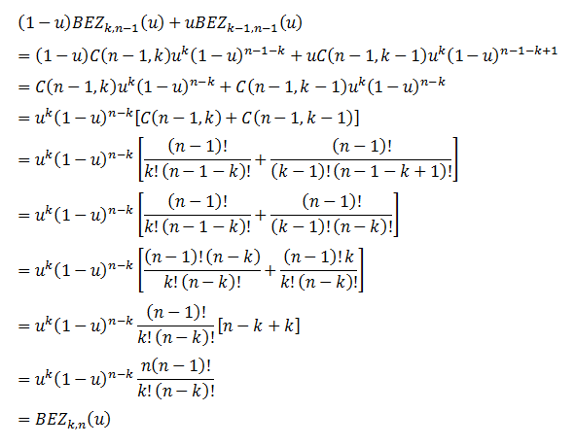
BEZIER CURVES AND SURFACES

Slide 11



Slide 12

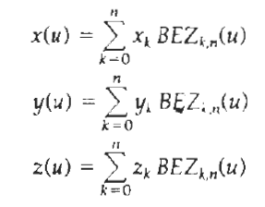
BEZIER CURVES AND SURFACES
Equivalently, we can define Bezier blending functions with the recursive calculation:
Vector equation 10-40 represents a set of three parametric equations for the individual curve coordinates
Eq. 10.40

Slide 13
BEZIER CURVES AND SURFACES
As a rule,
a Bezier curve is a polynomial of degree one less than the number of control points used:
Three points generate a parabola,
four points a cubic curve, and so forth.

Slide 14
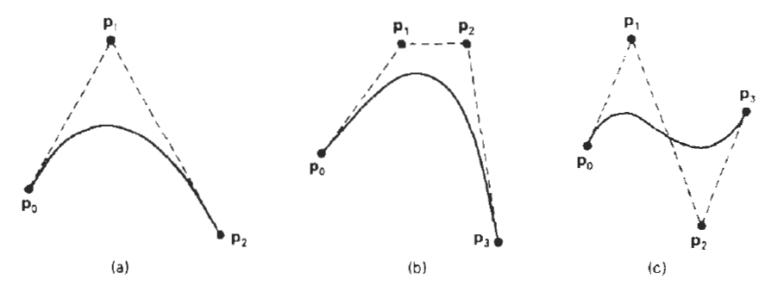
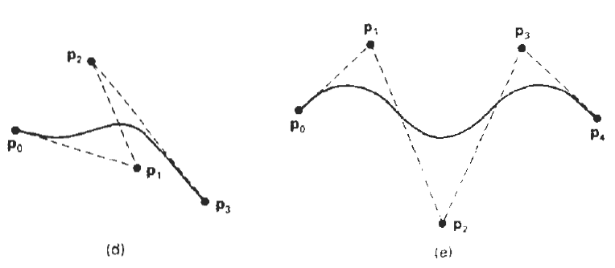
Some Examples

Slide 15
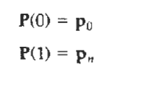
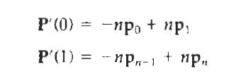
Properties of Bezier Curve
1# A very useful property of a Bezier curve is that it always passes through the first and last control points.
That is, the boundary conditions at the two ends of the curve are
2# Values of the parametric first derivatives of a Bezier curve at the endpoints can he calculated from control-point coordinate as

Slide 16
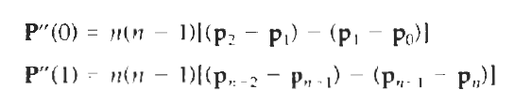
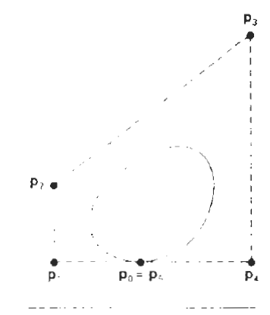
Properties of Bezier Curve
3# The parametric second derivatives of a Bezier curve at the endpoints are calculated as
4# Another important property of any Bezier curve is that it lies within the convex hull (convex polygon boundary) of the control points

Slide 17

Properties of Bezier Curve
5# The sum of Bezier blending function is 1

Slide 18
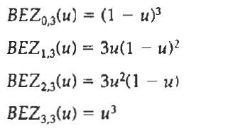
Cubic Bezier Curve
Cubic Bezier curves are generated with four control points.
The four blending functions for cubic Bezier curves, obtained by substituting n = 3 into Eq. 10-41.
How???

